Slide 1
Multiplying Polynomials
Integrated mathematics

Slide 2
Objectives
Students will multiply monomials with binomials and trinomials through the application of the distributive property.
Students will multiply binomials through the application of the distributive property.

Slide 3
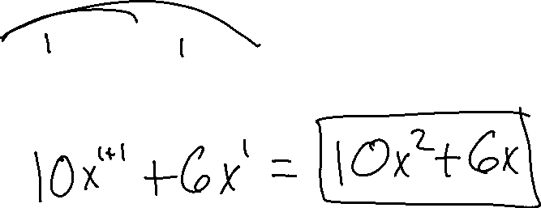
Simplify using the distributive property
Example 1
2x ( 5x + 3 )

Slide 4

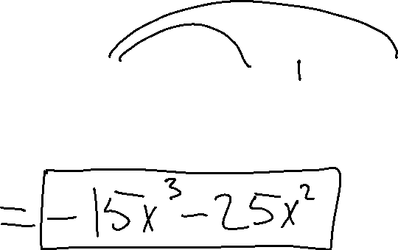
Example 2
$$−{5x}^{2}(3x+5)$$

Slide 5
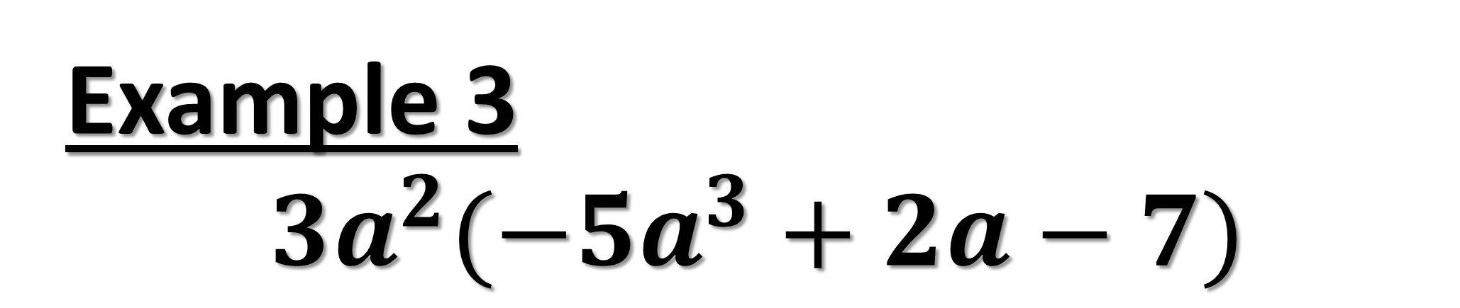
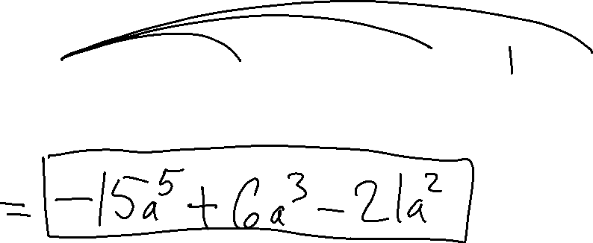
Example 3
$${3a}^{2}({−5a}^{3}+2a−7)$$

Slide 6
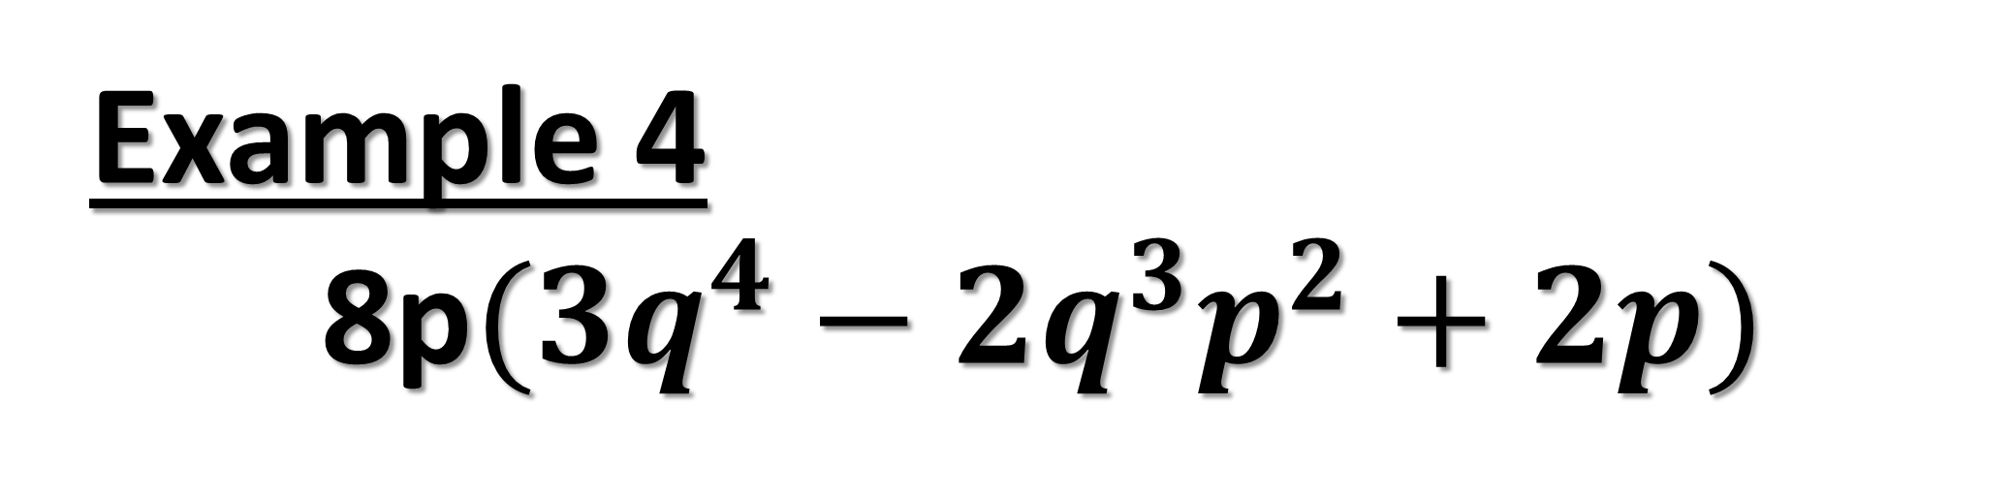
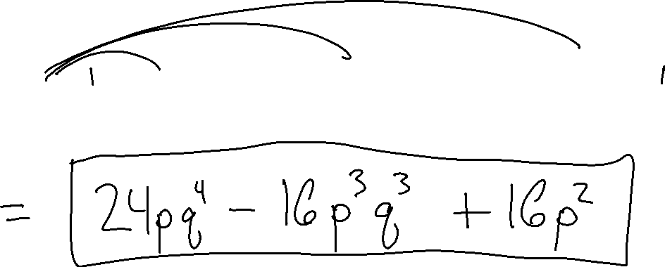
Example 4
8p$({3q}^{4}−2q^{3}p^{2}+2p)$

Slide 7
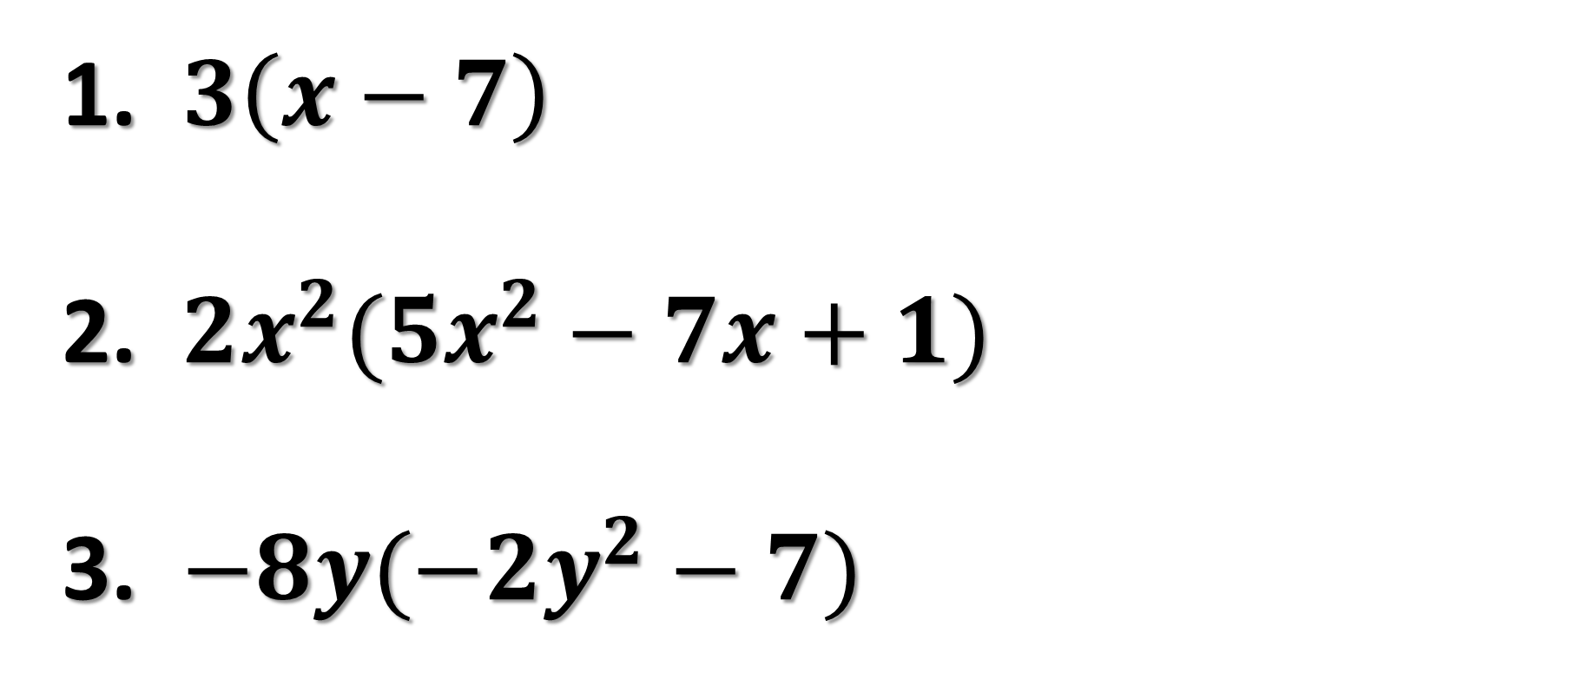
Try on your own
$3\left(x−7\right)$
${2x}^{2}({5x}^{2}−7x+1)$
${−8y(−2y}^{2}−7)$

Slide 8

Ticket out the door
$5t(2t−4)$
${4xy}^{2}(2x^{5}−4y)$
Rate yourself +, -, or o.

Slide 9
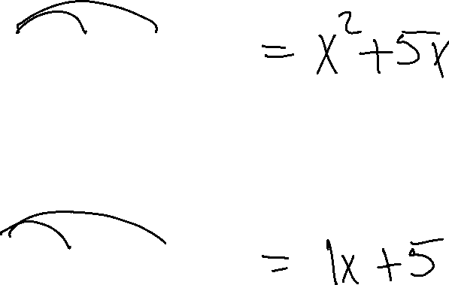
Multiplying Binomials
x ( x + 5 )
1 ( x + 5 )

Slide 10
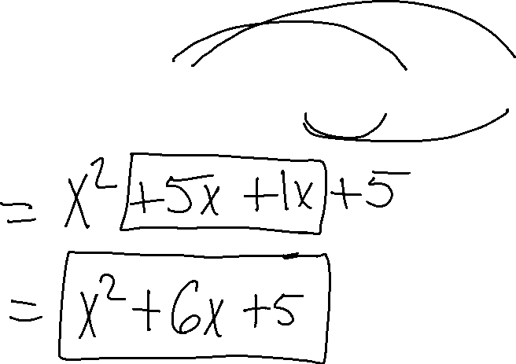
Ex. 5
( x + 1) ( x + 5 )

Slide 11
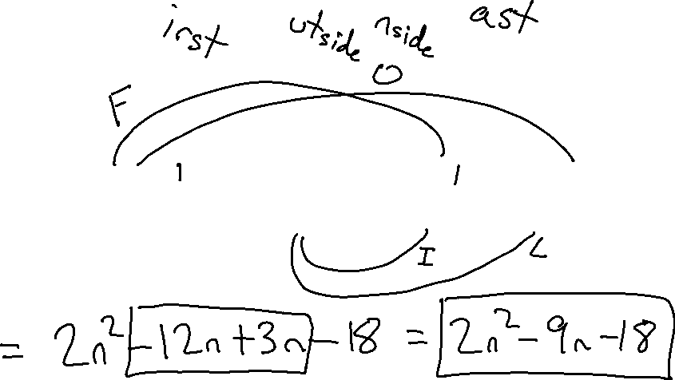
F O I L
Ex. 6
( 2n + 3) ( n - 6 )

Slide 12
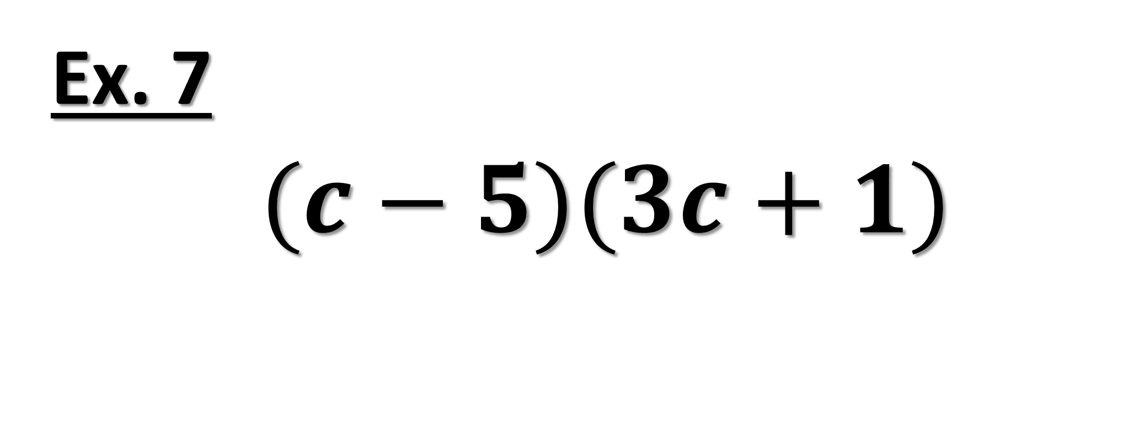
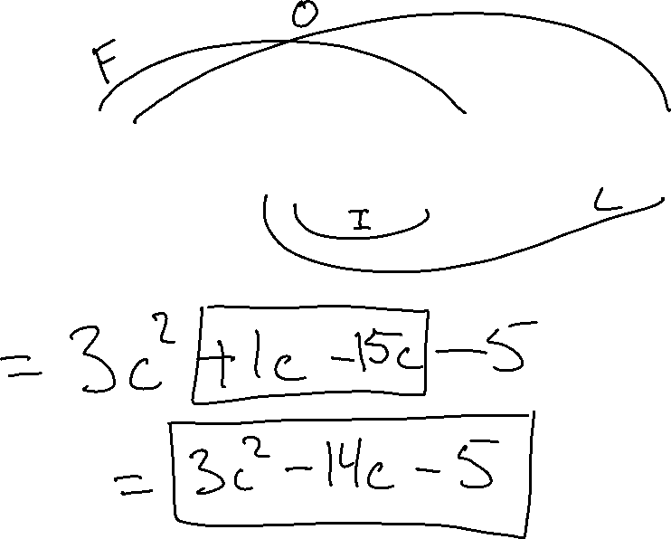
Ex. 7
$(c−5)(3c+1)$

Slide 13
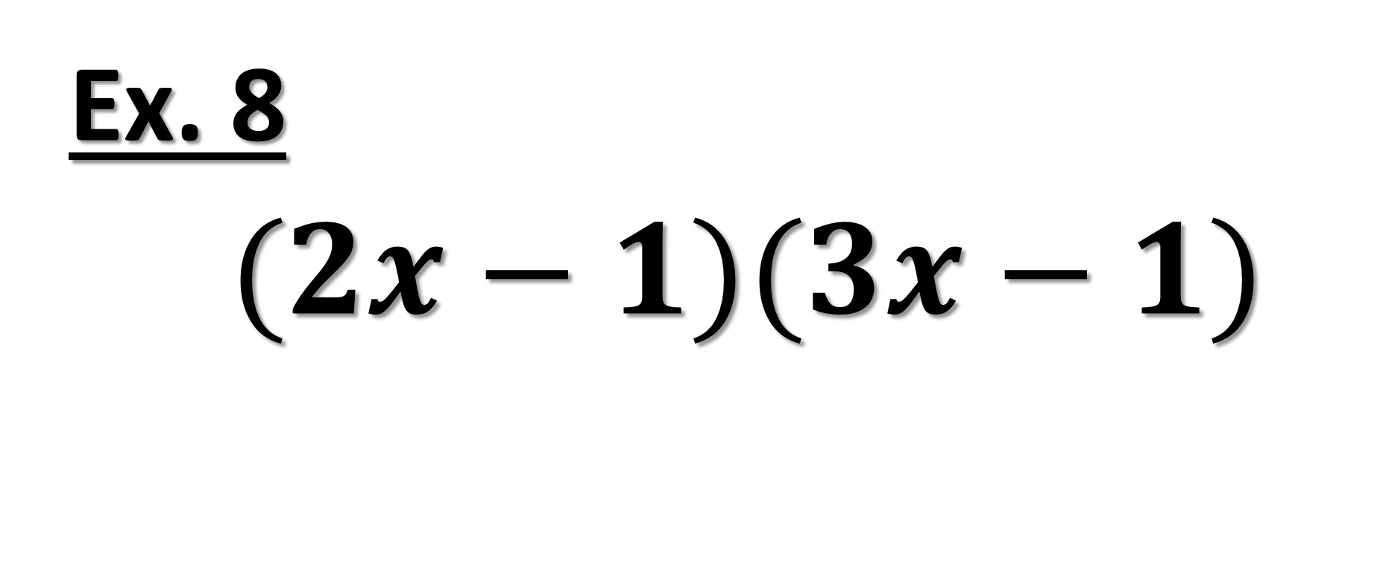
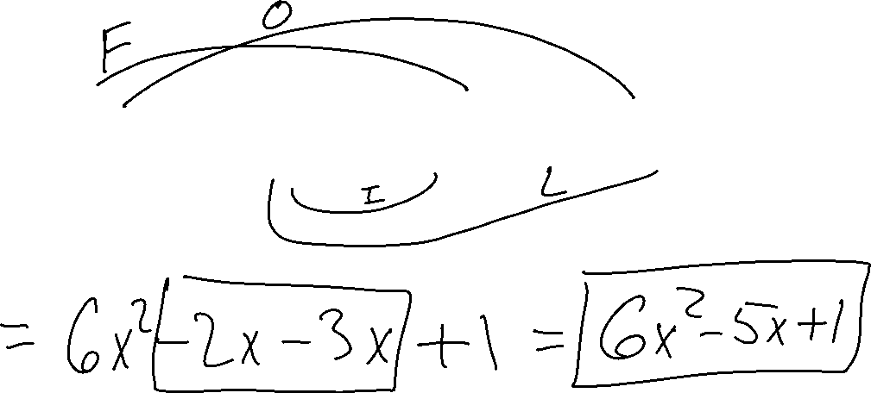
Ex. 8
$(2x−1)(3x−1)$

Slide 14
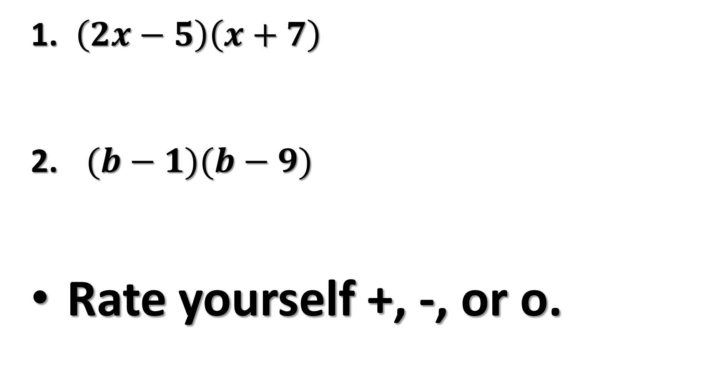
Ticket out the door
$\left(2x−5\right)\left(x+7\right)$
$(b−1)(b−9)$
Rate yourself +, -, or o.

Slide 15

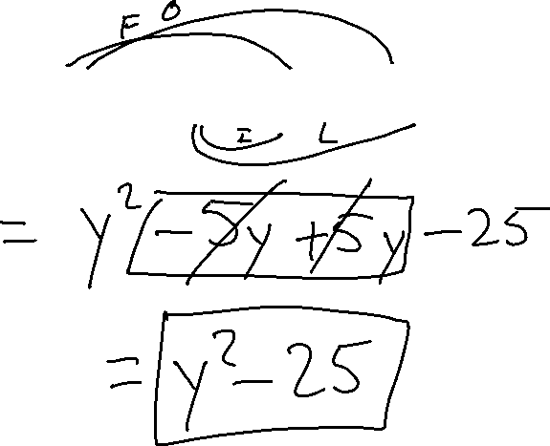
Special Cases
Example 9
$$(y+5)(y−5)$$

Slide 16

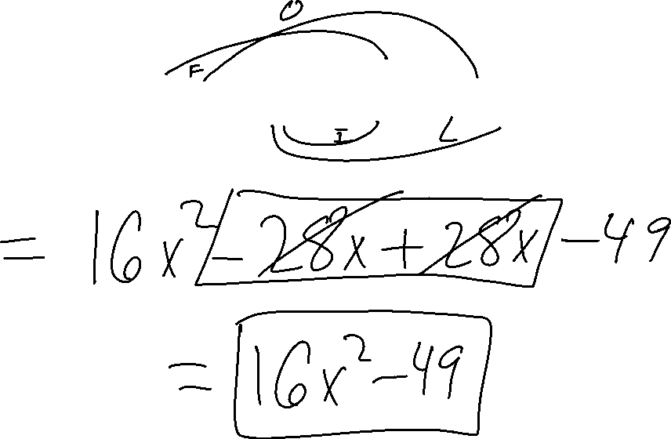
Example 10
$$(4x+7)(4x−7)$$

Slide 17

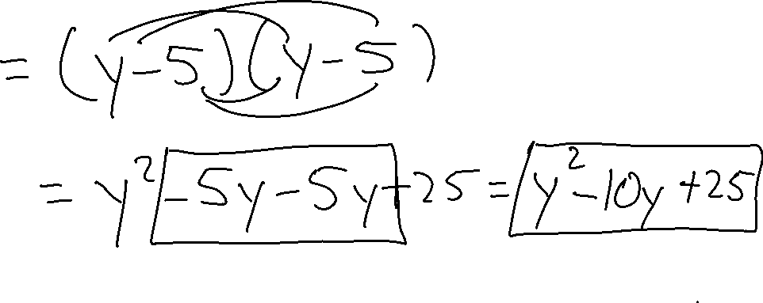
Example 11
$$({y−5)}^{2}$$

Slide 18

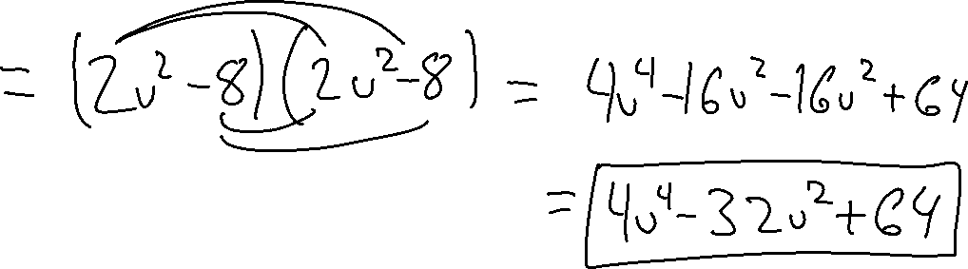
Example 12
$$({{2v}^{2}−8)}^{2}$$

Slide 19
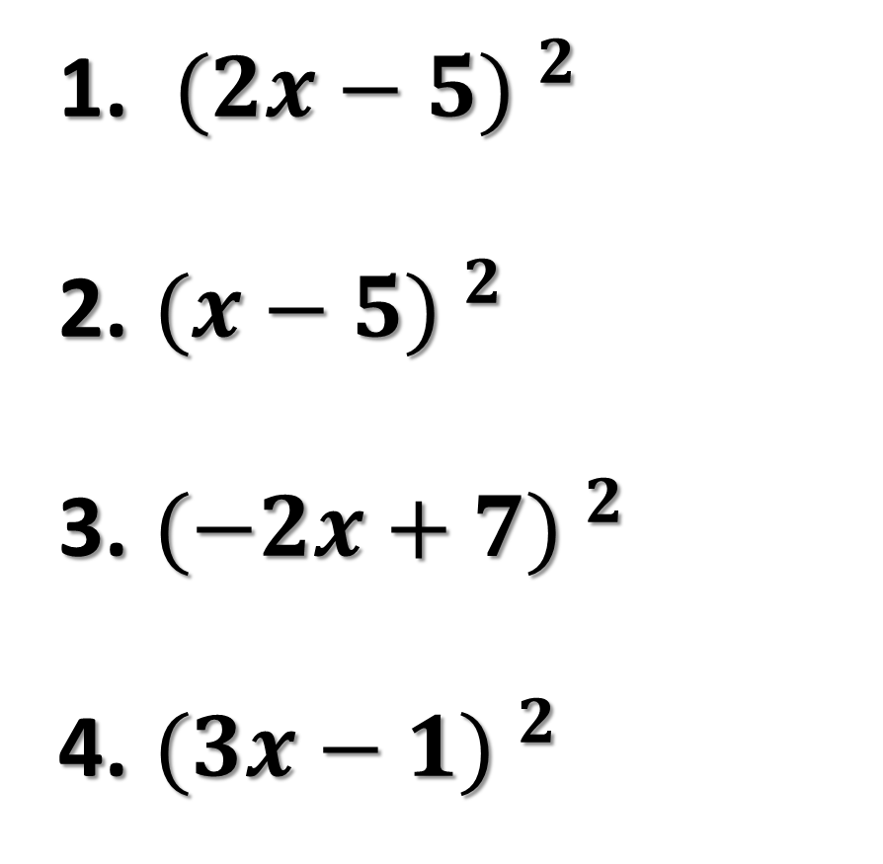
Try on your own
${(2x−5) }^{2}$
${(x−5) }^{2}$
${(−2x+7) }^{2}$
${(3x−1) }^{2}$

